Slide 1
GRADE 4
Review 1

Slide 3
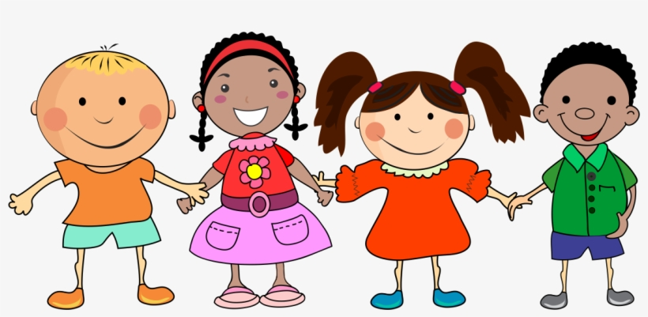
Let’s Play
HIDDEN PICTURE game.

Slide 5
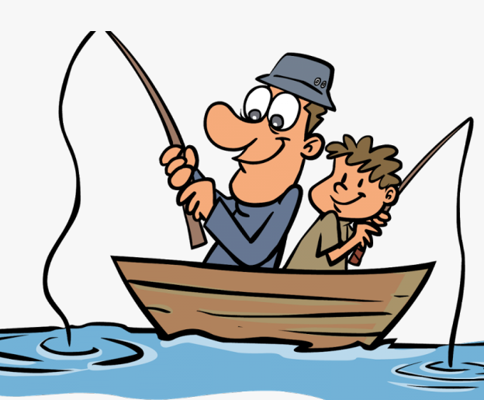

Slide 6
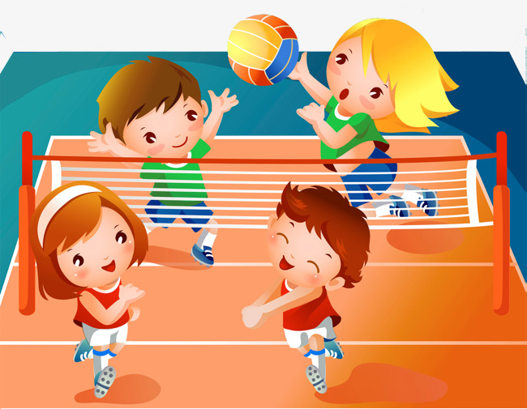

Slide 7
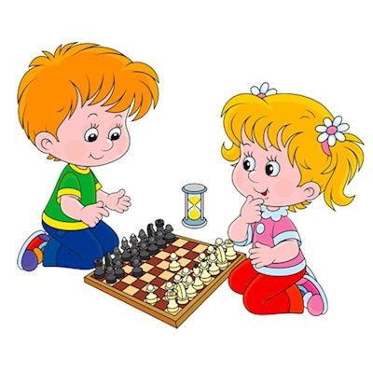

Slide 10
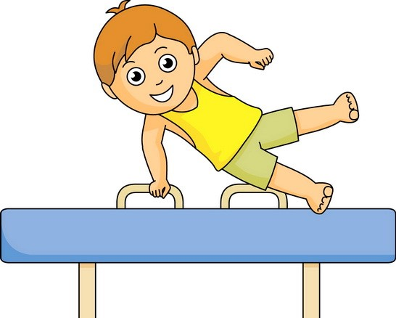

Slide 11
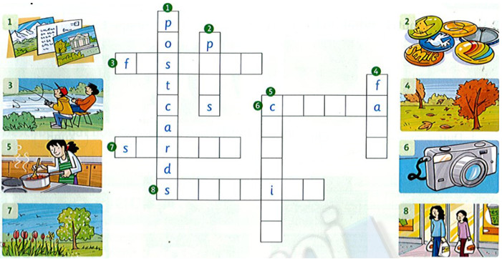
1.Complete the crossword.

Slide 12
1. Complete the crossword.
i
h
i
n
g
n
a
m
e
r
o
l
p
i
n
g
o
l
k
h
o
p
p
n
g
n
g

Slide 13
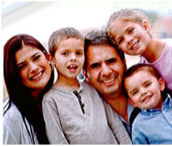
2. Write the correct words.
fishing / camera / playing / season / taking / country
Anne is nine. She's from Australia. Australia is a beautiful ¹_country_. Anne likes living in Australia. Her favorite ²____ is summer. Anne likes ³______ volleyball on the beach. She doesn't like ⁴_____ . She likes ⁵_______ photos. She has a great ⁶_____.

Slide 14
2. Write the correct words.
fishing / camera / playing / season / taking / country
Anne is nine. She's from Australia. Australia is a beautiful ¹_country_. Anne likes living in Australia. Her favorite ² season is summer. Anne likes ³playing volleyball on the beach. She doesn't like ⁴ fishing . She likes ⁵ taking photos. She has a great ⁶ camera.

Slide 16
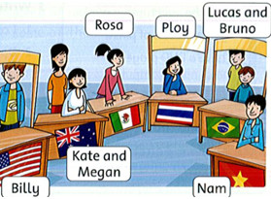
3. Read and write 'T' (true) or 'F' (false)
Nam is from Mexico. _F_
2. Lucas and Bruno are from
Brazil. ____
3. Billy is from Korea. ______
4. Rosa is from the U.S.A.
_____
5. Kate and Megan are from
Australia. ____
6. Ploy is from Thailand. ____
T
F
F
T
T

Slide 17
I YOU WE THEY
like
do not like = don’t like
SHE
HE
IT
likes
does not like = doesn’t like

Slide 18
I like reading.
She likes reading.

Slide 19
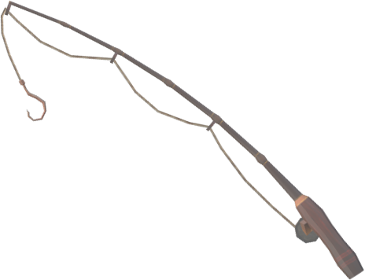
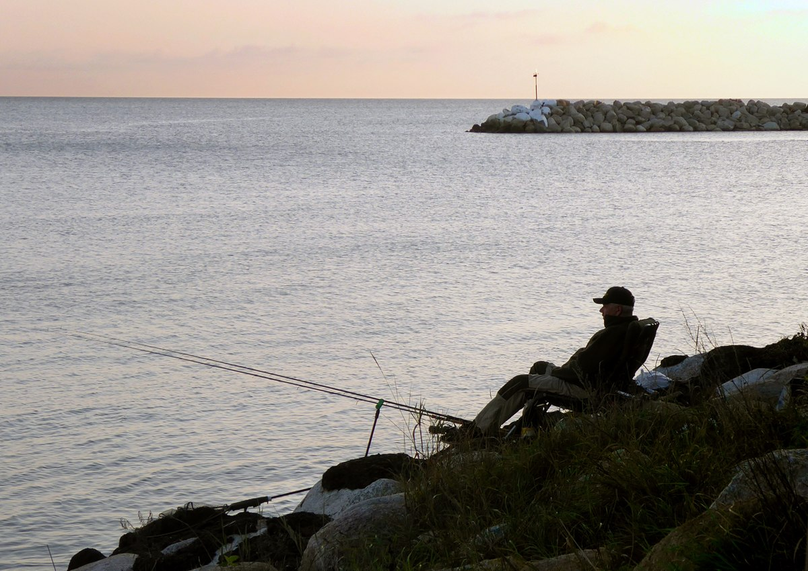
✗
I don’t like fishing.
He doesn’t like fishing.
✗

Slide 20
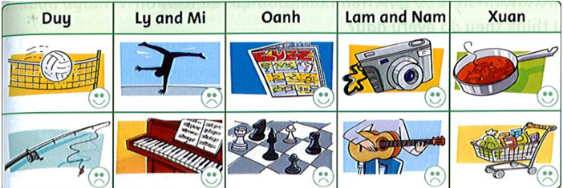
don’t like
4.Write: like / likes / don't like / doesn't like. 1. Duy _likes_ playing volleyball. He doesn't like fishing.
2. Ly and Mi ____ doing gymnastics. They _____ playing the piano.
3. Oanh ____ reading comics. She _____ playing chess.
4. Lam and Nam _____ taking photos. They _____ playing the guitar.
5. Xuan ____ cooking. She ____ shopping.
like
likes
doesn’t like
like
don’t like
likes
doesn’t like

Slide 21
3
4
2

Slide 22
u
e
o
e
a
e
o
e

Slide 23
Workbook time!!! Page: 26,27

